Slide 1
Database Management Systems
 

Slide 2
Objectives
At the end of this session, you will be able to:
  Recognize the need for Database
  Understand the DBMS Architecture
  Identify different Database Users & their roles
  Understand different Data Models
  Understand the Entity Relationship Model
  Understand extended E-R Diagrams
Readings:
Silberschatz, Korth & Sudarshan, Database System
 
CONFIDENTIAL© Copyright 2008 Tech Mahindra Limited

Slide 3
Agenda
The Database Concept
DBMS Architecture
Types of Database Users
Data Models
Entity Relationship Model
Extended E-R Diagram
CONFIDENTIAL© Copyright 2008 Tech Mahindra Limited

Slide 4
Introduction to Database Concept
 

Slide 5
Introduction to Data Processing
Data is an essential part of our everyday life
Some day-to-day interactions where information is stored in a systematic manner:
  Banking – Customer, Accounts, Loans and various banking
  transactions
  Airlines – Flights, Schedules, Reservations etc.
  Universities – Students, Courses, Registrations, Grades etc.
  Finance – Accounts, Sales, Purchase etc.
CONFIDENTIAL© Copyright 2008 Tech Mahindra Limited
Notes:
Introduction
Databases and database systems have become an essential part of our everyday life. We almost have daily interaction with databases. This examples include deposit or withdrawal from a bank, Apna Bazaar, Railway reservation, Airline reservation, library, Multimedia Databases that store pictures, video clips and sound messages. Geographical Information System that can store maps, weather data and satellite images, etc. and Real time databases that can control industrial and manufacturing processes.

Slide 6
The Database Concept
Database is a collection of inter-related data
Database Management System (DBMS) is a set of programs to use and / or modify this data
A computer based systematic record keeping system
But why do we need a Database System?
To describe it, let us first discuss the alternative to it, i.e. the File-Based System
What is wrong with the traditional file processing system?
CONFIDENTIAL© Copyright 2008 Tech Mahindra Limited

Slide 7
Drawbacks of File System
Data redundancy and inconsistency
Difficulty in accessing data
Concurrent access anomalies
Security Problem
Integrity Problem
CONFIDENTIAL© Copyright 2008 Tech Mahindra Limited
Notes:
Data Redundancy and Inconsistency: Since data resides in different private data files, there are chances of redundancy and resulting inconsistency. For example, in the above example shown, the same customer can have a savings account as well as a mortgage loan. Here the customer details may be duplicated since the programs for the two functions store their corresponding data in two different data files. This gives rise to redundancy in the customer's data. Since the same data is stored in two files, inconsistency arises if a change, made in the data in one file, is not reflected in the other.
Unanticipated Queries: In a file-based system, handling sudden/ad-hoc queries can be difficult, since it requires changes in the existing programs.
Concurrent Access Anomalies: In large multi-user systems the same file or record may need to be accessed by multiple users simultaneously. Handling this in file-based systems is difficult.
Security Problems In data-intensive applications, security of data is a major concern. Users should be given access only to required data and not the whole database. In a file-based system, this can be handled only by additional programming in each application.
Integrity Problems In any application, there will be certain data integrity rules which need to be maintained. These could be in the form of certain conditions/constraints on the elements of the data records. In the savings bank application, one such integrity rule could be “Customer ID, which is the unique identifier for a customer record, should be non-empty”. There can be several such integrity rules. In a file-based system, all these rules need to be explicitly programmed in the application program.
It may be noted that, we are not trying to say that handling the above issues like concurrent access, security, integrity problems, etc., is not possible in a file-based system. The real issue is that, though all these are common issues of concern to any data-intensive application, each application had to handle all these problems on its own. The application programmer needs to bother not only about implementing the application business rules but also about handling these common issues.

Slide 8
A Simplified Database System
Users / Programmers
 
Application Programs / Queries
 
S/W to process Queries
 
S/W to access data
 
Meta
-Data
Data
 
 
CONFIDENTIAL© Copyright 2008 Tech Mahindra Limited
Notes:
The User/ Programmer interacts with the database systems with either an interface or directly a query. The query is further processed and analyzed by a software and further forwarded to the Software for data access. For data access the meta-data is referenced and finally the data is fetched from the databases.

Slide 9
Database System
Meta-Data | Data about data
Database | A collection of related data
DBMS | A collection of programs that enable users to create & maintain a Database
Database System | The database & software together
CONFIDENTIAL© Copyright 2008 Tech Mahindra Limited

Slide 10
Schemas & Instances
Schemas | Description / Overall design of database
Instance | The data in the database at a particular moment in time
CONFIDENTIAL© Copyright 2008 Tech Mahindra Limited

Slide 11
Example: Schema & Instance
Schema
EmpNo Name Dept Sal
1234 Vikas Admin 10000
5678 Sachin Finance 30000
1357 Kiran HR 20000
2468 Manoj Admin 15000
Instance
CONFIDENTIAL© Copyright 2008 Tech Mahindra Limited
Notes:
Instances changes more frequently than Database schema

Slide 12
DBMS Architecture
View 1
View 2
….
View n
Conceptual Schema
Internal Schema
Database
CONFIDENTIAL© Copyright 2008 Tech Mahindra Limited
Notes:
The architecture of the DBMS can be viewed as a 3-level system comprising the following:
- The internal or the physical level where the data resides.
- The conceptual level which is the level of the DBMS functions
The external level which is the level of the application programs or the end user.
Data Independence is isolating an upper level from the changes in the organization or structure of a lower level. For example, if changes in the file organization of a data file do not demand for changes in the functions in the DBMS or in the application programs, data independence is achieved. Thus Data Independence can be defined as immunity of applications to change in physical representation and access technique. The provision of data independence is a major objective for database systems.

Slide 13
Schema
Internal Schema
  Describes physical storage of the structure
  (data storage & access paths)
Conceptual Schema
  Describes the structure of the entire database
  Hides details of the physical storage structures
View
  Describes the part of database which a particular user is interested in
CONFIDENTIAL© Copyright 2008 Tech Mahindra Limited

Slide 14
Data Independence
Logical Data Independence
  It is possible to change the conceptual schema without having to change external schema or application programs
Physical Data Independence
  It is possible to change the internal schema without having to change the conceptual schema
CONFIDENTIAL© Copyright 2008 Tech Mahindra Limited

Slide 15
DBMS Languages
Data Definition Language (DDL)
Data Manipulation Language (DML)
Data Control Language (DCL)
CONFIDENTIAL© Copyright 2008 Tech Mahindra Limited
Notes:
1) DDL:
A database schema is specified by a set of language known as DDL
A Data Definition Language (DDL) is a computer language for defining data
DDL SQL commands include the following:
Create - To make a new database, table, index, or stored query
Drop - To destroy an existing database, table, index, or view
Alter - To modify an existing database object
Truncate - To irreversibly clear a table
2) DML:
A DML is a language that enables users to access or manipulate data
DML implies:
Insertion
Deletion
Modification
3) DCL:
Provides internal security to a database by granting privileges (actions such as insert, update, delete or select) against database objects such as tables to every user.
GRANT and REVOKE
Two DCL operations that SQL uses to maintain security.

Slide 16
Data Dictionary
The results of compilation of DDL statements affect some set of tables which are stored in a file called Data Dictionary
CONFIDENTIAL© Copyright 2008 Tech Mahindra Limited

Slide 17
Types of Database Users
Database Administrator (DBA)
Database Managers (DBM)
Database Users
CONFIDENTIAL© Copyright 2008 Tech Mahindra Limited

Slide 18
Database Administrators
A person having central control of both data & programs accessing that data (over the system)
CONFIDENTIAL© Copyright 2008 Tech Mahindra Limited

Slide 19
Functions of DBA
Schema definition
Storage structure & access method definition
Schema & physical organization modification
Granting authorization for data access
Specifying integrity constraints---pk,fk,check,default,any other constraints
Performance tuning
Network administration
Database backup & recovery
CONFIDENTIAL© Copyright 2008 Tech Mahindra Limited

Slide 20
Database Manager
A program module
Provides an interface between the low-level data stored in database & the application programs and queries submitted to the system
CONFIDENTIAL© Copyright 2008 Tech Mahindra Limited

Slide 21
Functions of DBM
Interaction with the File Manager
Integrity Enforcement
Security Enforcement
Backup & Recovery
Concurrency Control
CONFIDENTIAL© Copyright 2008 Tech Mahindra Limited

Slide 22
Database Users
Casual | Occasional users; Middle level or high level managers
Naïve | Constantly query or update the database
Sophisticated | Implement their application to meet their complex requirements
System Analyst | Determine requirements and develop specifications
Application Programmer | Implement Specifications
CONFIDENTIAL© Copyright 2008 Tech Mahindra Limited

Slide 23
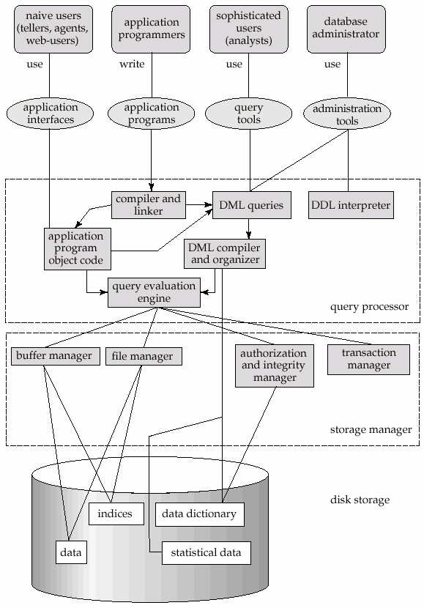
Detail System Architecture
CONFIDENTIAL© Copyright 2008 Tech Mahindra Limited
Notes:
While discussing detail system architecture, just take the recap of all the small points discussed earlier, i.e. database mgr, file magr, data file, data dictionary ect

Slide 24
Detail System Architecture
Components include:
File Manager: Manages allocation of disk space & data structures used to represent information on disk
Database Manager: Is the interface between low-level data and application programs & queries
Query Processor: Translates statements in a query language into low-level instructions which the database manager understands
CONFIDENTIAL© Copyright 2008 Tech Mahindra Limited

Slide 25
Detail System Architecture (Contd…)
DML Precompiler
  Converts DML statements embedded in an application program to normal procedure calls in a host language
  Interacts with the Query Processor
DDL Compiler
  Converts DDL statements to a set of tables containing metadata stored in a data dictionary
CONFIDENTIAL© Copyright 2008 Tech Mahindra Limited

Slide 26
Detail System Architecture (Contd...)
In addition, several data structures are required for physical system implementation
  Data files → Store the database itself
  Data dictionary →
    Stores information about the structure of the database
    It is used heavily
    Great emphasis should be placed on developing a good design and efficient implementation of the dictionary
  Indices → Provide fast access to data items holding particular values
CONFIDENTIAL© Copyright 2008 Tech Mahindra Limited

Slide 27
Data Models

Slide 28
Data Models
Data Models
Object Based Logical Models
Record Based Logical Models
Semantic Models
Network Model
Object Oriented model
Hierarchical Model
ER-Model
Relational Model
CONFIDENTIAL© Copyright 2008 Tech Mahindra Limited

Slide 29
Relational Data Models
A Database consists of multiple Relations
Information about an enterprise is broken up into parts, with each relation storing one part of the information
Each part is termed as Table and rows of a table are termed as Tuples and columns as Attributes
CONFIDENTIAL© Copyright 2008 Tech Mahindra Limited

Slide 30

Relational Data Models (Contd…)
The Customer Relation
CONFIDENTIAL© Copyright 2008 Tech Mahindra Limited

Slide 31
Entity-Relationship Model
This database model is based on
  A collection of entities, &
  Relationship among entities
An entity is an object that exists and is distinguishable from other objects
  Example: A specific person, company, event, plant etc.
CONFIDENTIAL© Copyright 2008 Tech Mahindra Limited
Notes:
E-R Model is covered in more details in the following slides

Slide 32

Entity-Relationship Model (Contd…)
A Relationship is an association among several entities
CONFIDENTIAL© Copyright 2008 Tech Mahindra Limited
Notes:
E-R Model is covered in more details in the following slides

Slide 33
Network Data Model
Data is represented by collection of records
  Similar to an entity in the E-R model
  Records & their fields are represented as a record type
Relationships among data are represented by links
CONFIDENTIAL© Copyright 2008 Tech Mahindra Limited

Slide 34
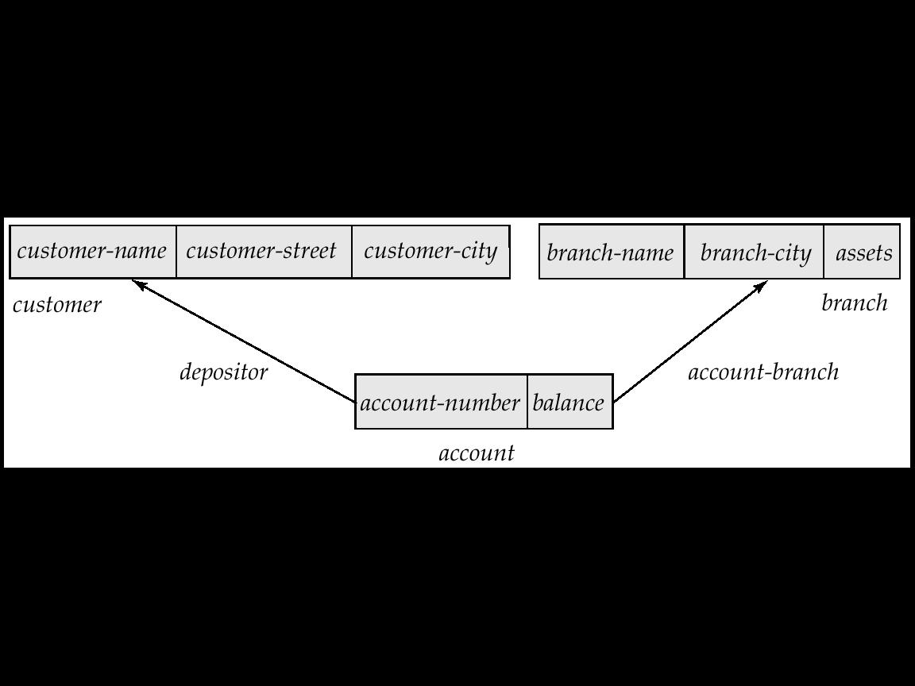
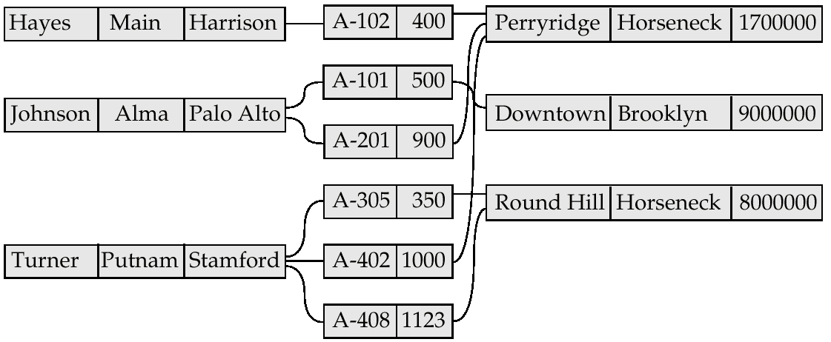
Network Data Model (Contd…)
CONFIDENTIAL© Copyright 2008 Tech Mahindra Limited

Slide 35
Hierarchical Data Model
A Hierarchical database consists of a collection of records that are connected to one another through links
A record is a collection of fields, and each field contains only one data value
Differs from the Network Model in that the records are organized as collections of trees rather than as arbitrary graphs
A link is an association between two records
CONFIDENTIAL© Copyright 2008 Tech Mahindra Limited

Slide 36
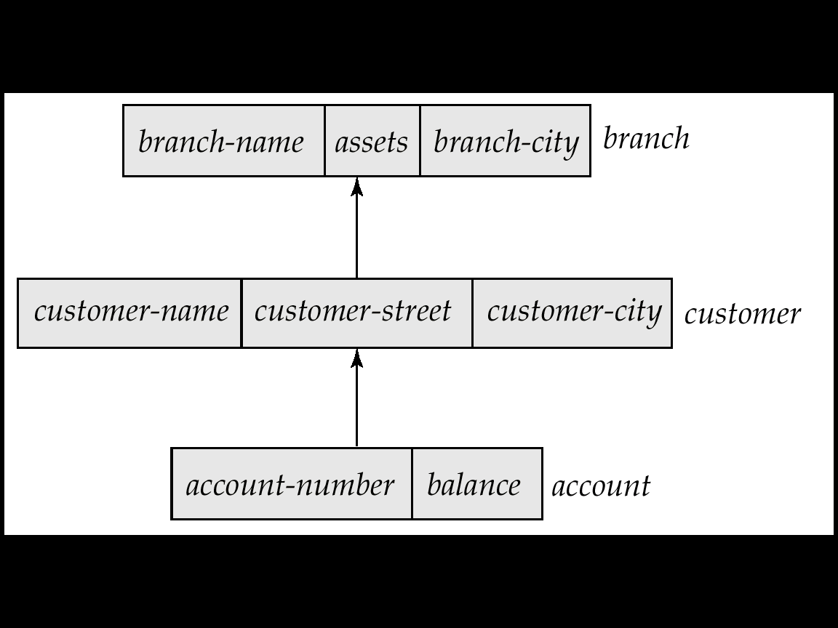
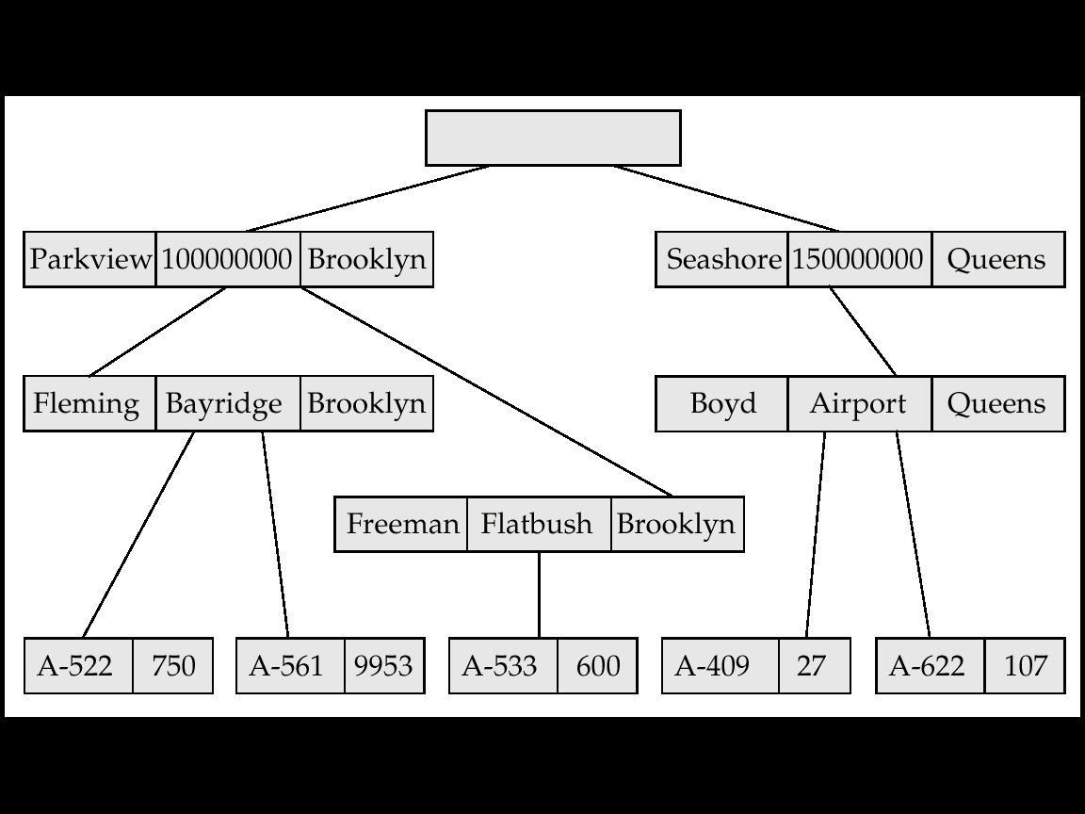
Hierarchical Data Model (Contd…)
CONFIDENTIAL© Copyright 2008 Tech Mahindra Limited

Slide 37
Object-Relational Data Models
Built on top of relational data models by including object orientation and constructs to deal with added data types
Allow attributes of tuples to have complex types, including non-atomic values such as nested relations
Provide a convenient migration path for users of RDBMS who wish to use OO features
Compatibility with existing relational languages such as SQL
CONFIDENTIAL© Copyright 2008 Tech Mahindra Limited

Slide 38
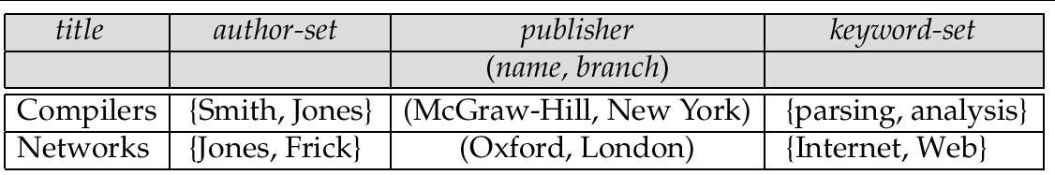
Object-Relational Data Models (Contd…)
Example → Library Information System
Each book has:
  Title
  A set of authors
  Publisher
  A set of keywords
Relation BOOKS with composite attributes
CONFIDENTIAL© Copyright 2008 Tech Mahindra Limited

Slide 39
Entity Relationship Model

Slide 40
Purpose of ER Model
To express the logical properties of the database in an enterprise schema
To express the logical structure of the model
Used mainly as a design tool and documentation for the system
Describes the environment in terms of entities
CONFIDENTIAL© Copyright 2008 Tech Mahindra Limited

Slide 41
Entity Relationship Model
An entity is an object or concept about which we store information
Strong Entity / Dominant Entity: An entity which has its own identifier, and is not built from another entities’ identifier
Weak Entity: An entity which borrows its identity from at
least one other entity
Employee
Dependent
CONFIDENTIAL© Copyright 2008 Tech Mahindra Limited
Notes:
Entities :
To interpret the relational database you perceive the real world as a set of objects and relationships between these objects. These basic objects are called entities.

Slide 42
Identifying Entities
Given a system description we can identify entities by:
  Select all nouns
  Eliminate the one’s not necessary
  Filter those for which system needs to store records
  Identify the attributes that describe the entity
  Check how many records could be created for the same
CONFIDENTIAL© Copyright 2008 Tech Mahindra Limited

Slide 43
ERM – Important Definitions
Entity Set
  An entity set is a set of entities of the same type that share the same properties or attributes
Attributes
  Attributes are descriptive properties possessed by each member of an entity set
CONFIDENTIAL© Copyright 2008 Tech Mahindra Limited

Slide 44
Attribute Types
Simple:
e.g. Empno
Composite:
e.g. Ename – fname, mname, lname
Empno
F_Name
Emp-Name
M_Name
L_Name
CONFIDENTIAL© Copyright 2008 Tech Mahindra Limited

Slide 45
Attribute Types (Contd…)
  Single-Valued
  e.g. Studno
  Multi-Valued
  e.g. Contact_Number
  Derived
  e.g. Age (could be derived from Date of Birth)
Studno
Contact_Number
Age
CONFIDENTIAL© Copyright 2008 Tech Mahindra Limited

Slide 46
Entity Relationship (Contd…)
Relationship
A relationship is an association among several entities. Applies when you want to keep track of connection between two distinct entities
Identifying a Relationship
Special type of relationship that applies when we have weak entity
Belongs to
EMP
DEPT
EMP
Has
Dependant
CONFIDENTIAL© Copyright 2008 Tech Mahindra Limited
Notes:
Examples:
Employee belongs to Department
Employee Has Dependent

Slide 47
ERM - Degree of Relationship
Unary: Degree 1
Binary: Degree 2
Ternary: Degree 3
N-ary: Degree n
EMPLOYEE
manages
Soc SNo
loan-no
amount
Cust-name
cust-city
borrower
CUSTOMER
LOAN
ORDER
Has
ITEM
Order_dtls
CONFIDENTIAL© Copyright 2008 Tech Mahindra Limited

Slide 48
Mapping Cardinalities
Mapping Cardinalities expresses the number of entities to which another entity can be associated via a relationship set
Possible mapping cardinalities:
  One-to-One: An entity in A is associated with only one entity in B and vice-versa e.g. College & Principal, Customer & Account with the condition that a customer can handle only one account
  One-to-Many: An entity in A is associated with any number (zero or more) of entities in B, however an entity in B is associated with at most one entity in A
College
1
Has
1
Principal
Works in
Department
1
M
Faculty
CONFIDENTIAL© Copyright 2008 Tech Mahindra Limited
Notes:
One-to-One:

Slide 49
Mapping Cardinalities (Contd…)
Many-to-One: An entity in A is associated with at most one entity in B & an entity in B is associated with any number in A
e.g. Customers & Joint Account, Employee & Department or an
Instructor & Courses taught
Course
M
Teaches
1
Instructor
Many-to-Many: Entities in A and B are associated with any number of entities from each other
e.g. Employees can be assigned to more than one Project & a
Project should be assigned to at least 3 employees
Assign To
Employee
M
N
Project
CONFIDENTIAL© Copyright 2008 Tech Mahindra Limited

Slide 50
Participation of Entity Sets in Relations
Total: The participation of an entity set E in a relationship set R is said to be total if every entity in E participates in at least one relationship R
Partial: Part of the set of entities participate in some relationship
EMP
Has
Dependant
Belongs to
EMP
DEPT
CONFIDENTIAL© Copyright 2008 Tech Mahindra Limited

Slide 51
ERM – A Recap
Overall logical structure of a database can be expressed graphically by an ER diagram
  Rectangles: Entity Sets
  Ellipses: Attributes (Simple, Single)
  Ellipses connected with many Ellipses: Composite Attributes
  Concatenated Ellipse: Multi-value Ellipse
  Dotted Ellipse : Derive Attribute
CONFIDENTIAL© Copyright 2008 Tech Mahindra Limited

Slide 52
ERM – A Recap (Contd…)
  Diamonds: Relationship Sets
  Lines: link Attributes to Entity Sets and Entity Sets to
  Relationship Sets
  Double Lines: Total Participation
  Double Rectangle: Weak Entity
  Attribute with an underline: Primary Key
____
CONFIDENTIAL© Copyright 2008 Tech Mahindra Limited

Slide 53
Entity Relationship Model
amount
Soc-SNo
loan-no
Cust-name
cust-city
borrower
Customer
loan
CONFIDENTIAL© Copyright 2008 Tech Mahindra Limited
Notes:
There are two entity sets Customer and Loan. They are having a relationship between them as borrower. Customer is having attributes like Cust_name,cust_city and social security number(SSN). Primary key is Soc S N. Loan entity set is having attributes like loan-no and amount. Loan-amount is a primary key.

Slide 54
ERM – An Example
fname
mname
lname
empno
detno
dname
loc
ename
sal
Belongs to
EMP
N
1
DEPT
1
No of hrs
1
M
has
Manages
Assigned to
N
N
1
DEPENDENTS
PROJECT
Dep_name
relation
proj_id
projname
CONFIDENTIAL© Copyright 2008 Tech Mahindra Limited

Slide 55
ERM - Explanation
This schema has 3 entity types:
  EMPLOYEE
  DEPT
  PROJECT
& 1 weak entity type DEPENDENT
There is an M:N relationship between PROJECT & EMP entity sets
There is a 1:1 relationship between DEPT & PROJECT
There is a 1:M relationship between DEPT & EMP entity sets
No of hrs is an attribute on the relation “assigned to” between EMP & PROJECT
There is total participation for DEPENDENT, since we can not have a Dependent without an Employee
CONFIDENTIAL© Copyright 2008 Tech Mahindra Limited

Slide 56
Extended E-R Diagram

Slide 57
Extended E-R Diagram: Specialization
A top-down design process
Designates sub groupings within an entity set that are distinctive from other entities in the set
These sub groupings become lower-level entity sets that have special attributes or participate in relationships
Depicted by a triangle component labeled IS A e.g. Customer “is a” Person
CONFIDENTIAL© Copyright 2008 Tech Mahindra Limited

Slide 58

Specialization (Contd…)
CONFIDENTIAL© Copyright 2008 Tech Mahindra Limited

Slide 59
Extended E-R Diagram: Generalization
A bottom-up design process
A number of entity sets that share the same features are combined into a higher-level entity set
Simple inversion of Specialization
Represented in an E-R diagram in the same way
CONFIDENTIAL© Copyright 2008 Tech Mahindra Limited
Notes:
Design Constraints on a Specialization/Generalization
Constraint on which entities can be members of a given lower-level entity set.
condition-defined
E.g. all customers over 65 years are members of senior-citizen entity set; senior-citizen ISA person.
user-defined
Constraint on whether or not entities may belong to more than one lower-level entity set within a single generalization.
Disjoint
an entity can belong to only one lower-level entity set
Noted in E-R diagram by writing disjoint next to the ISA triangle
Overlapping
an entity can belong to more than one lower-level entity set
Completeness constraint -- specifies whether or not an entity in the higher-level entity set must belong to at least one of the lower-level entity sets within a generalization.
total : an entity must belong to one of the lower-level entity sets
partial: an entity need not belong to one of the lower-level entity sets

Slide 60
Generalization (Contd…)
G
S
CONFIDENTIAL© Copyright 2008 Tech Mahindra Limited
Notes:
Design Constraints on a Specialization/Generalization
Constraint on which entities can be members of a given lower-level entity set.
condition-defined
E.g. all customers over 65 years are members of senior-citizen entity set; senior-citizen ISA person.
user-defined
Constraint on whether or not entities may belong to more than one lower-level entity set within a single generalization.
Disjoint
an entity can belong to only one lower-level entity set
Noted in E-R diagram by writing disjoint next to the ISA triangle
Overlapping
an entity can belong to more than one lower-level entity set
Completeness constraint -- specifies whether or not an entity in the higher-level entity set must belong to at least one of the lower-level entity sets within a generalization.
total : an entity must belong to one of the lower-level entity sets
partial: an entity need not belong to one of the lower-level entity sets

Slide 61
Extended E-R Diagram: Aggregation
In aggregation the aggregate entity set is treated as a single unit without concern for the details of its internal structure
E-R model doesn’t express Represent relationships among relationships
CONFIDENTIAL© Copyright 2008 Tech Mahindra Limited
Notes:
Relationship sets works-on and manages represent overlapping information
Every manages relationship corresponds to a works-on relationship
However, some works-on relationships may not correspond to any manages relationships
So we can’t discard the works-on relationship
Eliminate this redundancy via aggregation
Treat relationship as an abstract entity
Allows relationships between relationships
Abstraction of relationship into new entity
Without introducing redundancy, the following diagram represents:
An employee works on a particular job at a particular branch
An employee, branch, job combination may have an associated manager

Slide 62
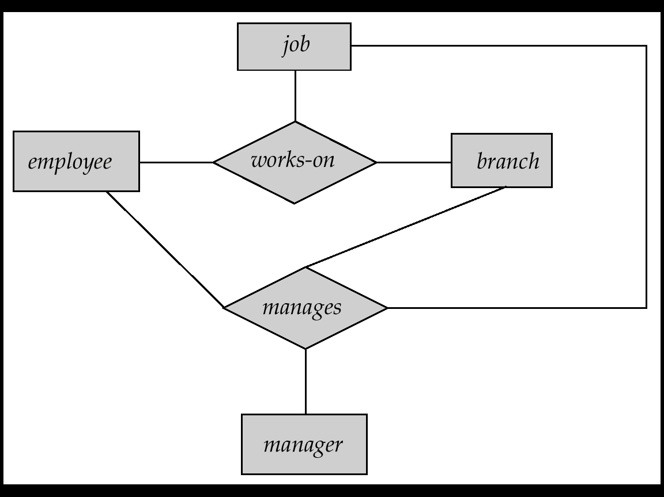

Aggregation (Contd…)
Suppose we want to record managers for tasks performed by an employee at a branch
CONFIDENTIAL© Copyright 2008 Tech Mahindra Limited
Notes:
Relationship sets works-on and manages represent overlapping information
Every manages relationship corresponds to a works-on relationship
However, some works-on relationships may not correspond to any manages relationships
So we can’t discard the works-on relationship
Eliminate this redundancy via aggregation
Treat relationship as an abstract entity
Allows relationships between relationships
Abstraction of relationship into new entity
Without introducing redundancy, the following diagram represents:
An employee works on a particular job at a particular branch
An employee, branch, job combination may have an associated manager

Slide 63
Aggregation (Contd…)
Building Composite Objects from Component Objects →
3 Cases:
  When the aggregate attribute values of an object forms a whole object
  When we view an aggregate relationship as ordinary relationship
  When we represent relationship among relationships
CONFIDENTIAL© Copyright 2008 Tech Mahindra Limited

Slide 64
Aggregation (Contd…)
1
COMPANY
Interviews
CANDIDATE
2
COMPANY
Interviews
CANDIDATE
JOB_OFFER
3
COMPANY
Interviews
CANDIDATE
Results_in
JOB_OFFER
CONFIDENTIAL© Copyright 2008 Tech Mahindra Limited

Slide 65
Aggregation (Contd…)
Interviews
4
COMPANY
CANDIDATE
Results_in
Aggregation Relationship
JOB_OFFER
CONFIDENTIAL© Copyright 2008 Tech Mahindra Limited

Slide 66
Summary
In this session, we learned:
  Database Concepts
  DBMS Architecture
  Types of Database Users
  Data Models
  Entity Relationship Model
  Extended E-R Diagram
CONFIDENTIAL© Copyright 2008 Tech Mahindra Limited

Slide 67
Thank You

